Slide 1
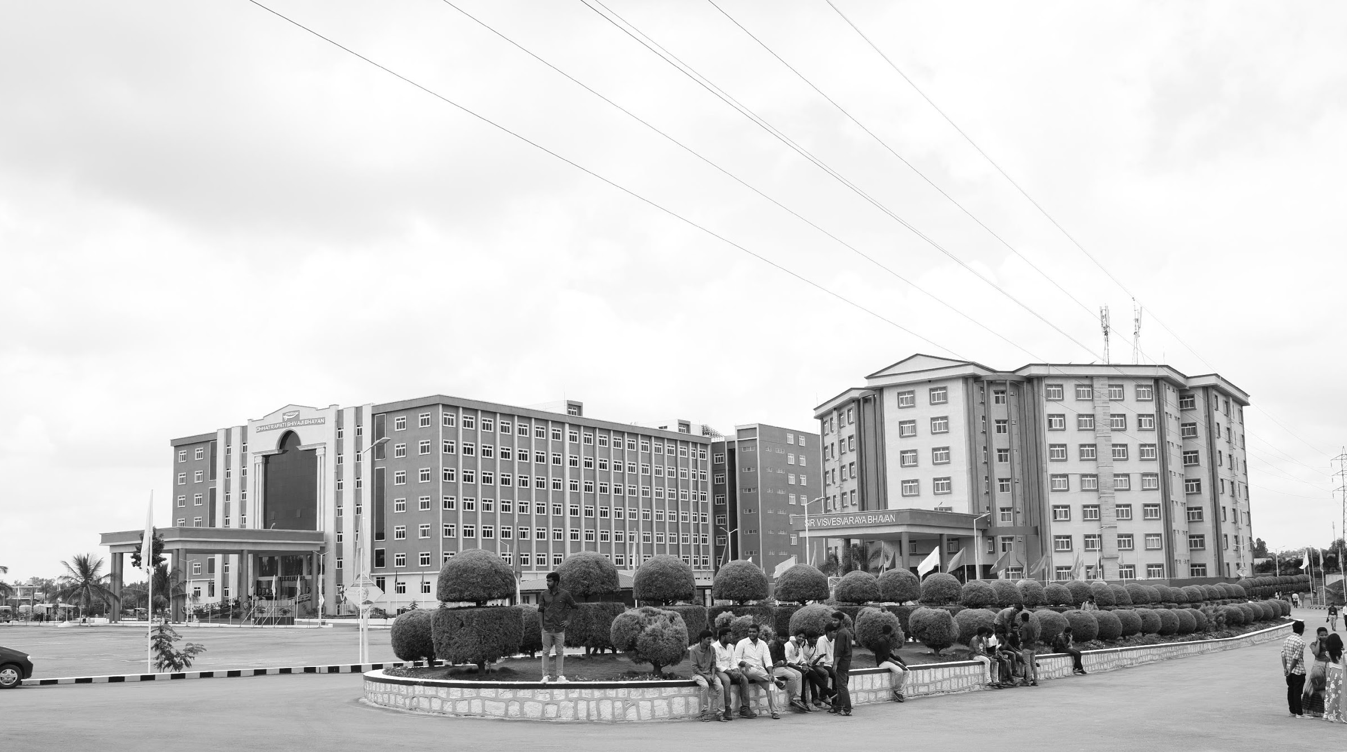

FUSING IMAGES FROM TWO MODES FOR HUMAN PERCEPTION
Mid-Review 3
Major Project
Project ID: CS14
AY 2021-25
GITAM (Deemed-to-be) University
Project Team:
Abhay Babu BU21EECE0100320
Sai Manjunath BU21EECE010442
Sai Krishna BU21EECE010320
Department of Electrical Electronics and Communication Engineering
Project Mentor:
Dr Koshy George
Project In-charge:
Dr Rohan Prasad
www.gitam.edu

Slide 2
Objective and Goals
Objective
This project aims to develop and evaluate image fusion techniques that seamlessly integrate the complementary features of visible-light and thermal images into a single, enhanced output. By exploring both conventional and machine learning-based methods, the goal is to preserve key details—such as texture, heat signatures, and contextual information—while ensuring high image quality, effective information retention, and computational efficiency. Emphasis will be placed on designing lightweight, real-time algorithms suitable for hardware implementation, with practical applications in fields like medical diagnostics, surveillance, and environmental monitoring.
Goals
Fusion in Multiple Color Spaces
Exhaustive Evaluation of Conventional Methods
Integration of Edge-Preserving Filters
Thermal-Visible Edge Overlay Fusion
Performance Analysis Across Methods
Real-Time Feasibility and Computational Efficiency
Comparative Study of Color Space Effects
Practical Application Validation

Slide 3
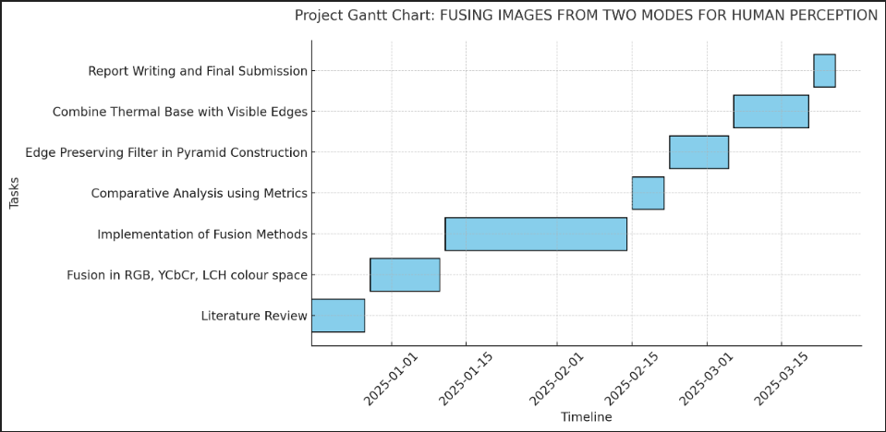
Project Plan (Clearly mention milestone for objectives under each reviews)
Gant Chart - Milestones and Activities

Slide 4
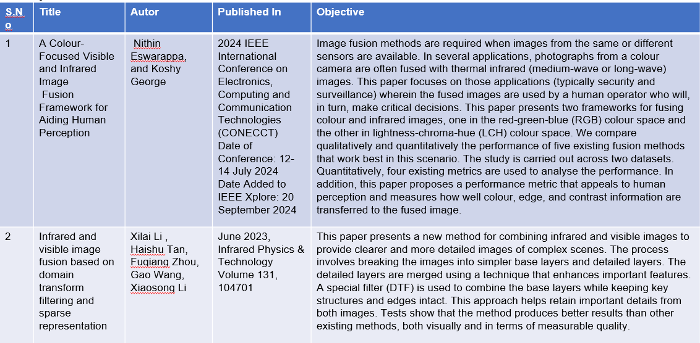
Literature Survey (Improved post minor project)
Key Publications

Slide 5
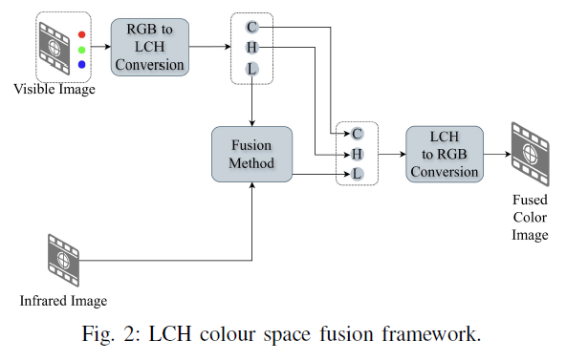
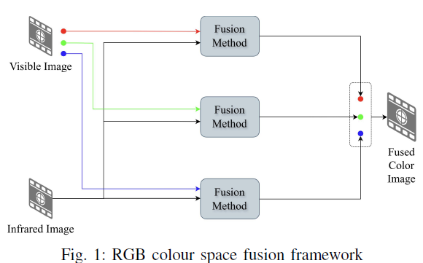
Architecture

Slide 6
Use Cases & Testing

Slide 7
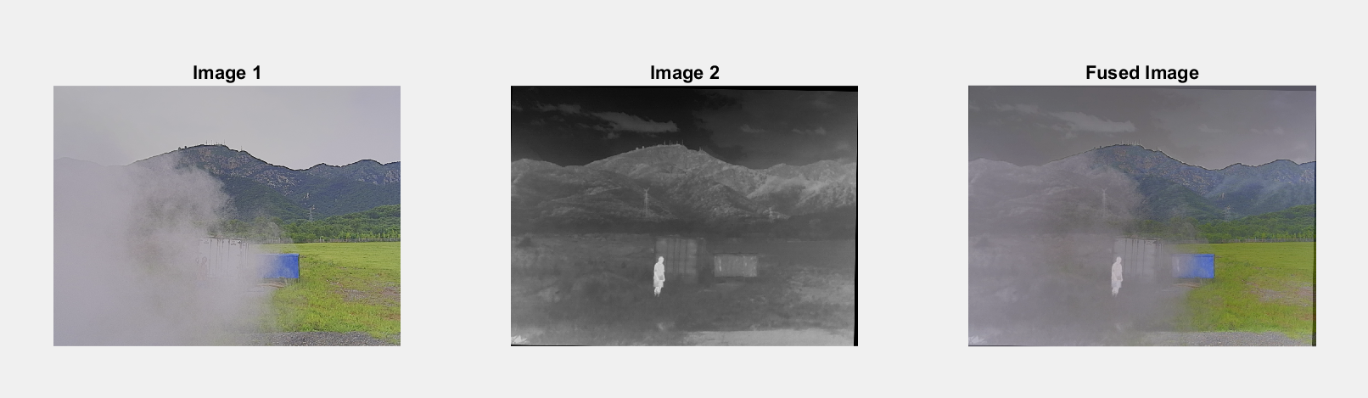
Implementation and Results – Iteration 1
Iteration 1 : Results
YCBCR IMPLEMENTATION AND RESULTS:-
YCbCr image fusion leverages the luminance (Y) and chrominance (Cb, Cr) components to effectively combine complementary features from multiple images. By fusing the Y channel, which contains intensity information, and preserving the Cb and Cr channels for color, the method ensures better visual clarity and detail retention. This approach minimizes color distortion and enhances the structural and contextual details in the fused output. It is particularly useful in applications like surveillance and low-light imaging, where preserving both brightness and color fidelity is critical.

Slide 8
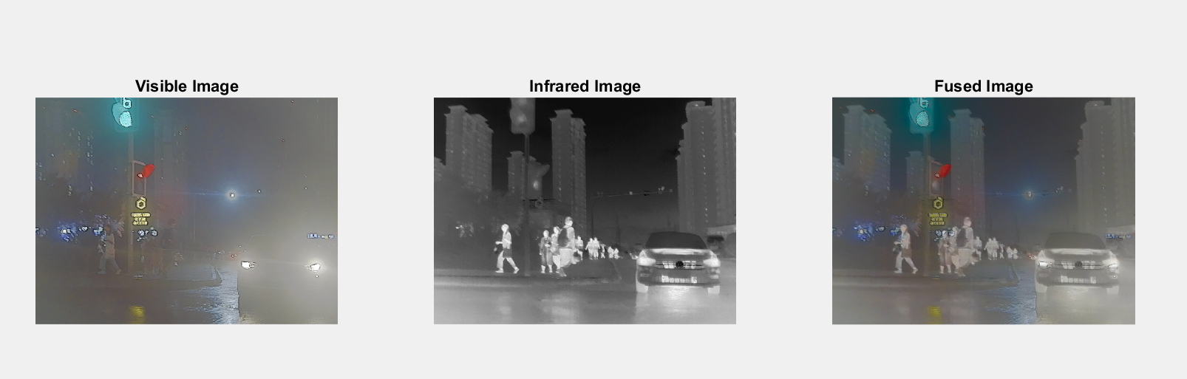
Implementation and Results – Iteration 2
LCH implementation and result:-
LCH image fusion operates in the Luminance (L), Chroma (C), and Hue (H) color space, enabling the separation of intensity and color information for more effective fusion. By fusing the L channel, which holds brightness details, while maintaining the C and H channels for color integrity, this method enhances both structural and color accuracy in the output. LCH fusion provides better contrast and visual clarity, making it ideal for applications where color perception and fine detail are critical, such as medical imaging and environmental monitoring.

Slide 9
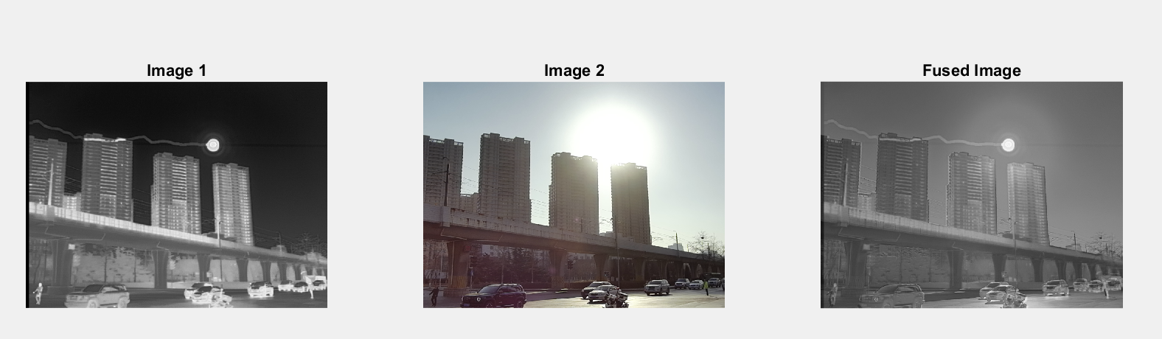
Implementation and Results – Iteration 3 (Optional)
LAB implementation and results:-
Lab image fusion uses the CIE Lab color space, which separates an image into Lightness (L) and color components (a and b) for more precise processing. The L channel, representing brightness, is typically fused to enhance structural details, while the a and b channels retain color fidelity. This method ensures better contrast, detail preservation, and minimal color distortion in the fused output. Lab image fusion is widely used in applications like remote sensing, medical diagnostics, and surveillance, where both clarity and accurate color representation are crucial.

Slide 10
Implementation of Image fusion method in RGB Color Space
Fusion methods
Laplacian pyramid fusion(LP Fusion)
Ratio pyramid fusion(RP Fusion).
Wavelet Transform (DWT, DTCWT).
Contourlet Transform (NSCT).
Curvelet Transform (CVT).
Laplacian Pyramid Fusion (LP)
Laplacian Pyramid Fusion (LP) is a multi-scale approach that decomposes images into different frequency bands using a Laplacian pyramid. The fusion process is applied at each level of the pyramid by selecting the most relevant details from both images. The fused image is then reconstructed by summing the pyramid levels. This method is effective in preserving edges and fine details while reducing redundancy in fused images. It is commonly used in multi-focus and medical imaging applications. However, it may introduce slight blurring if not handled properly.
Key Advantage: Good edge preservation.
Best For: Multi-focus image fusion.

Slide 11
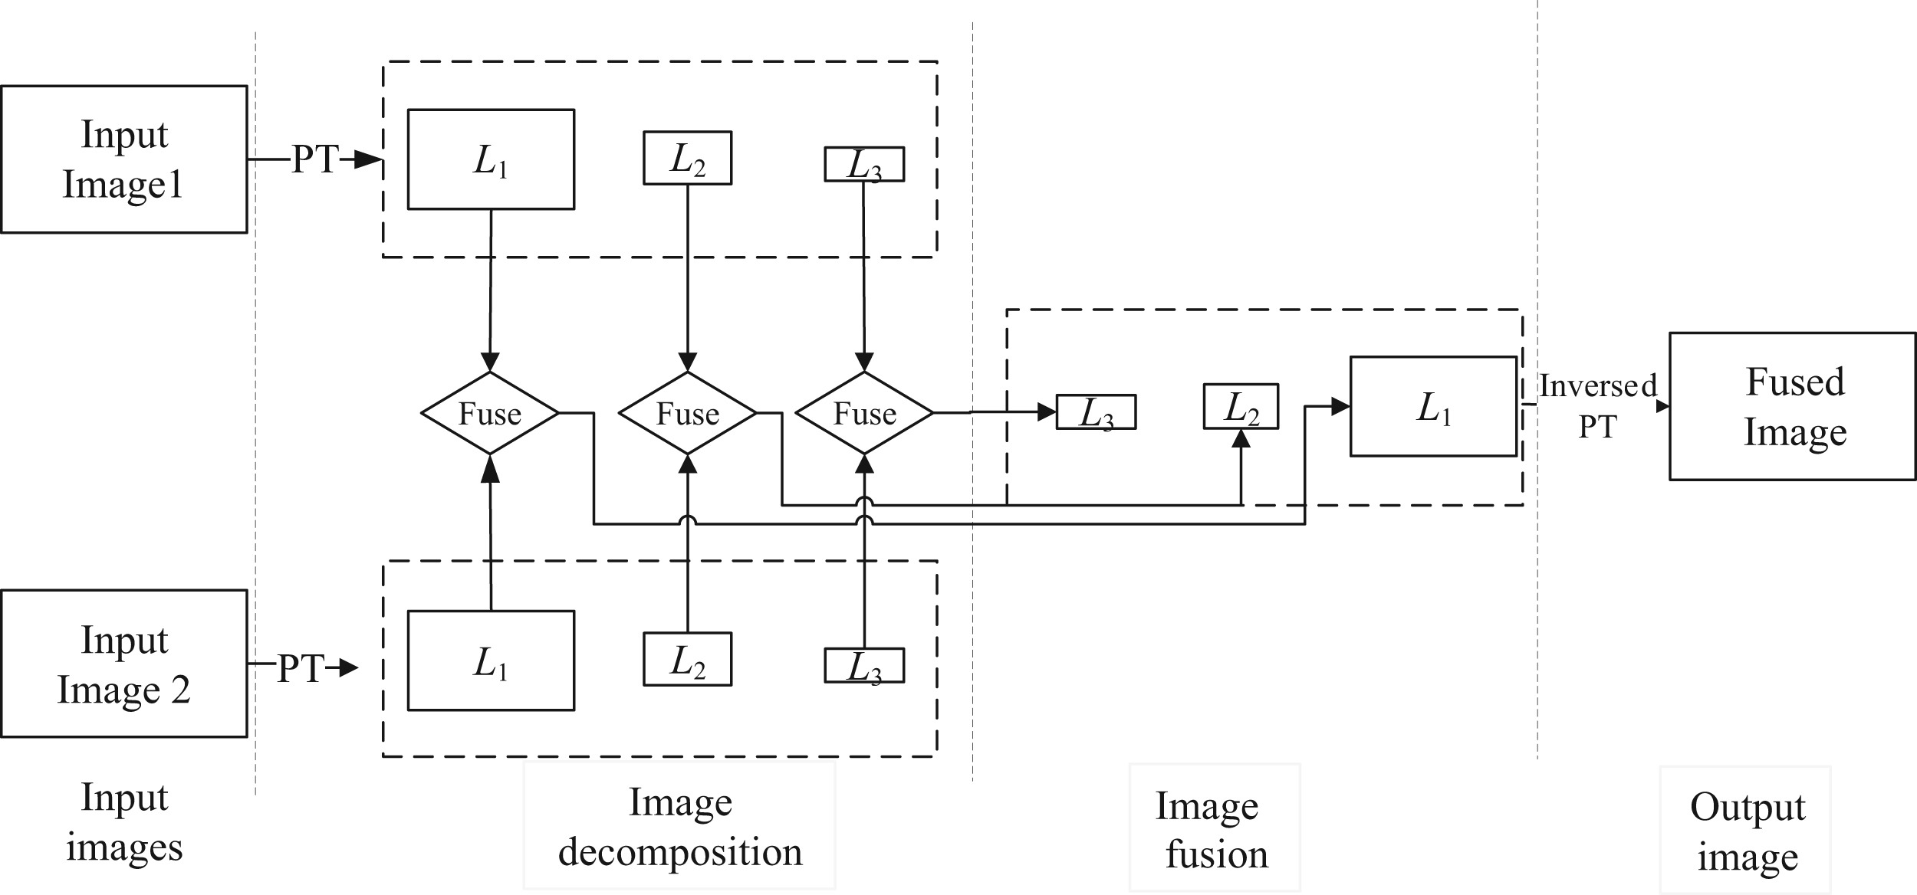
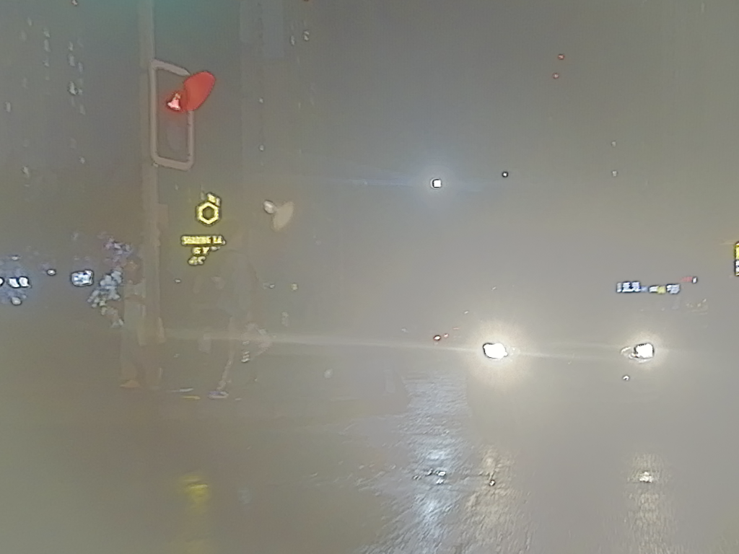
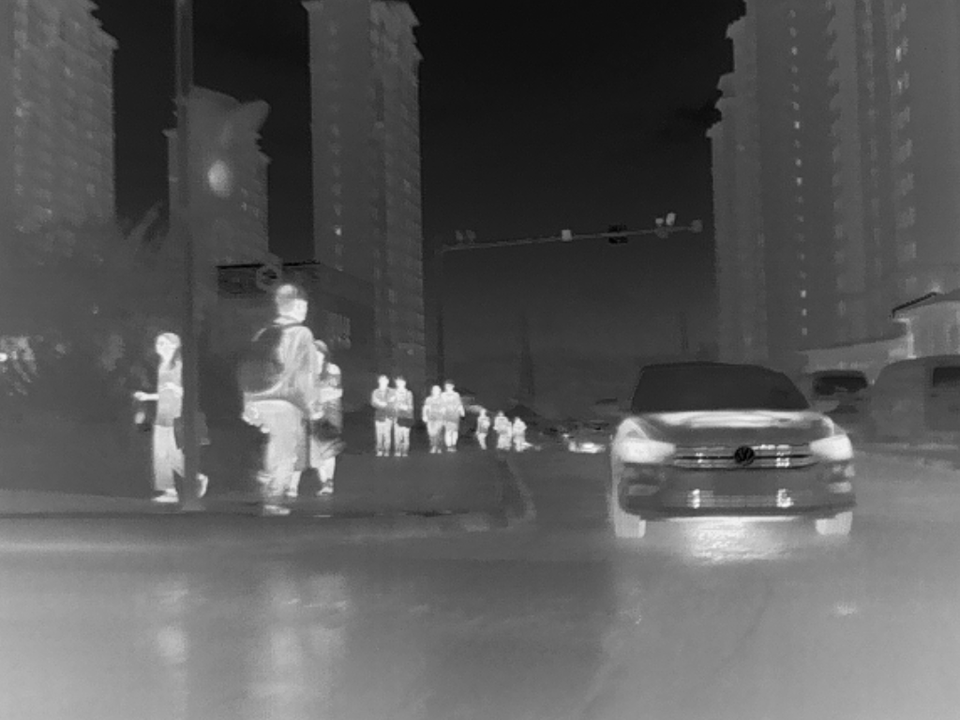
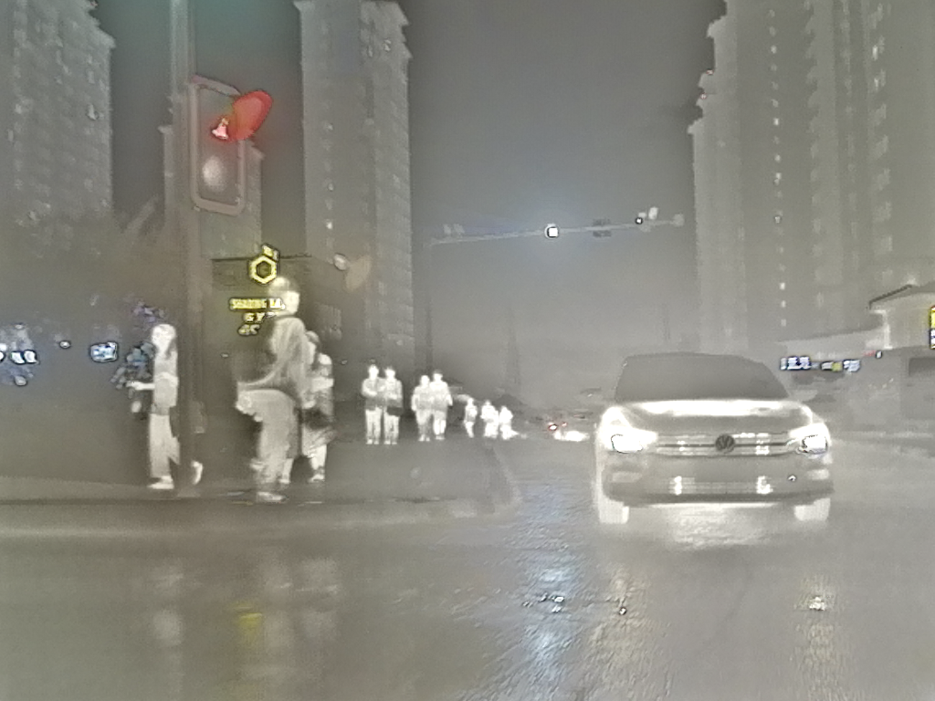

Slide 12
Ratio Pyramid Fusion (RP)
Ratio Pyramid Fusion (RP) is an alternative to LP fusion, utilizing ratio-based decomposition instead of subtractive differences. The main advantage of RP fusion is its ability to enhance contrast while maintaining sharpness. The images are decomposed into multiple ratio layers, fused separately, and then reconstructed into a single image. This method performs well in multi-modal image fusion, where the source images come from different sensors. However, it may amplify noise in some cases.
Key Advantage: Preserves contrast better than LP. Best For: Thermal-visible and multi-spectral fusion.
Future Work

Slide 13
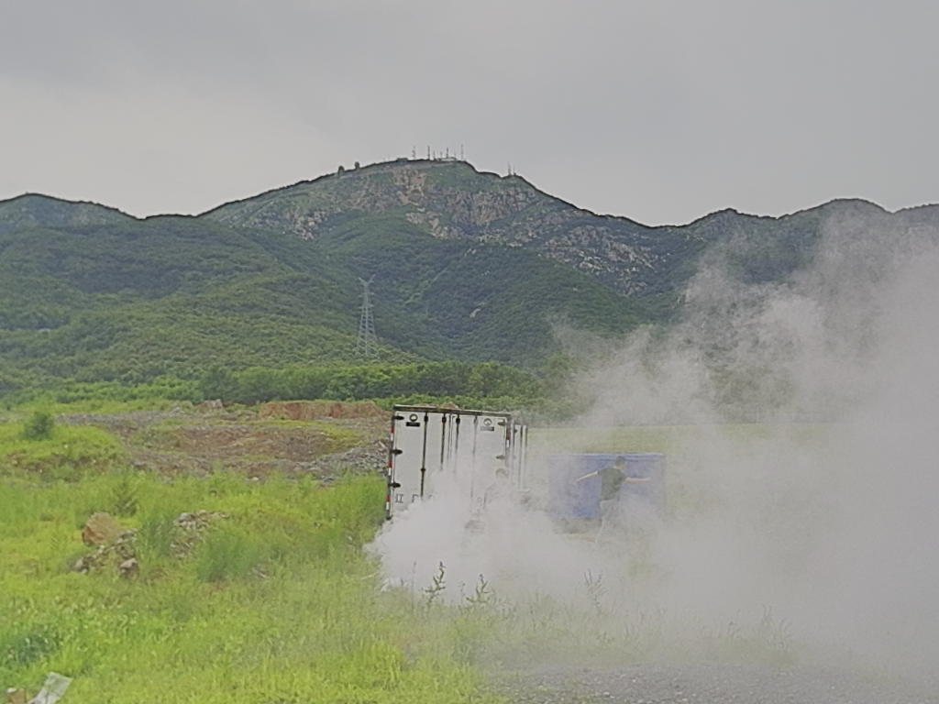
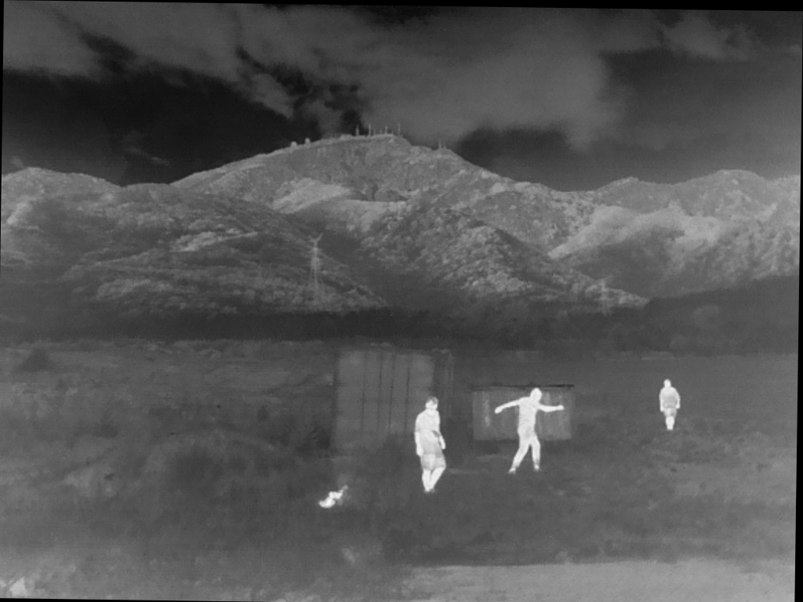
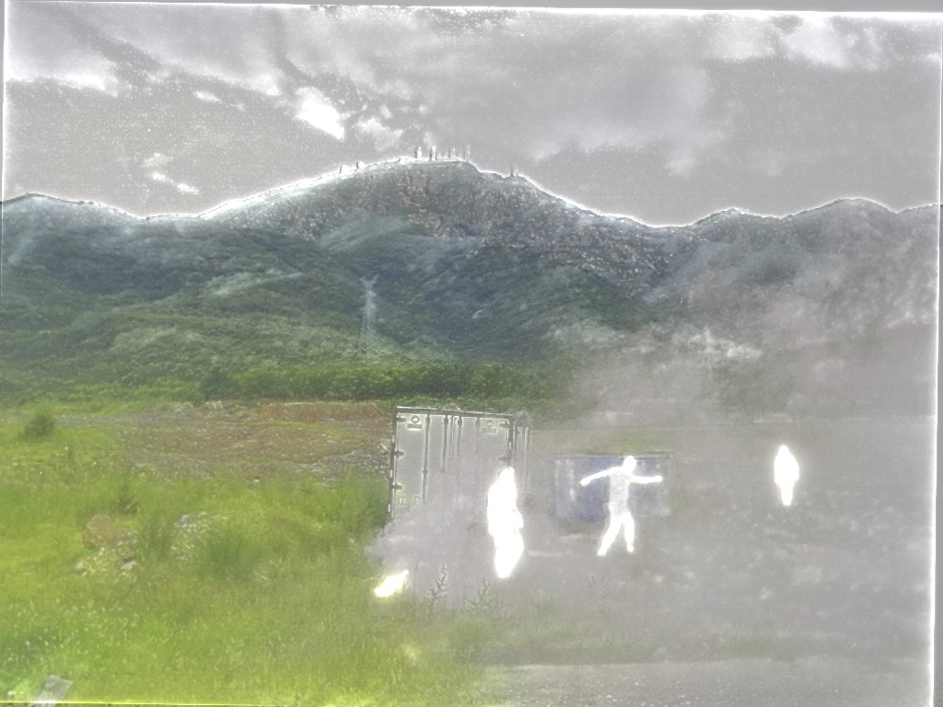

Slide 14
Discrete Wavelet Transform (DWT) Fusion
DWT fusion applies wavelet decomposition, separating images into low- and high-frequency components. Fusion is performed by merging the wavelet coefficients using selection rules such as maximum intensity, weighted averaging, or energy-based selection. After fusion, the inverse wavelet transform reconstructs the final image. DWT preserves edge information well, making it useful for remote sensing and medical imaging. However, shift sensitivity and loss of spatial information can be drawbacks.
Key Advantage: Effective texture and detail preservation. Best For: Remote sensing and multi-resolution analysis.

Slide 15
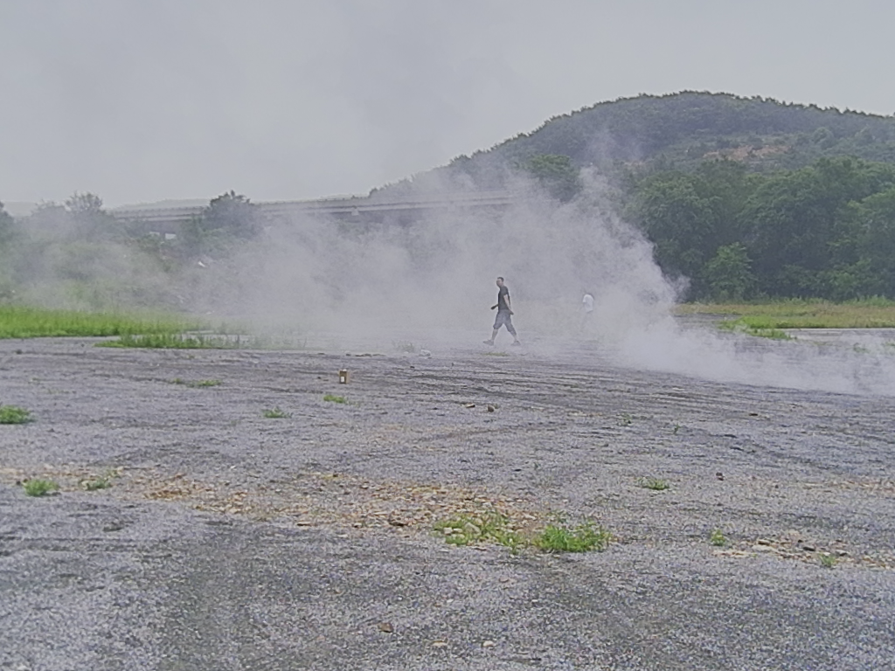
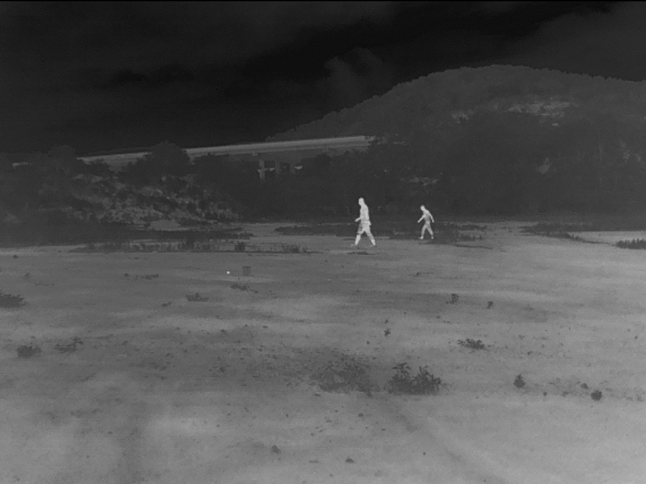
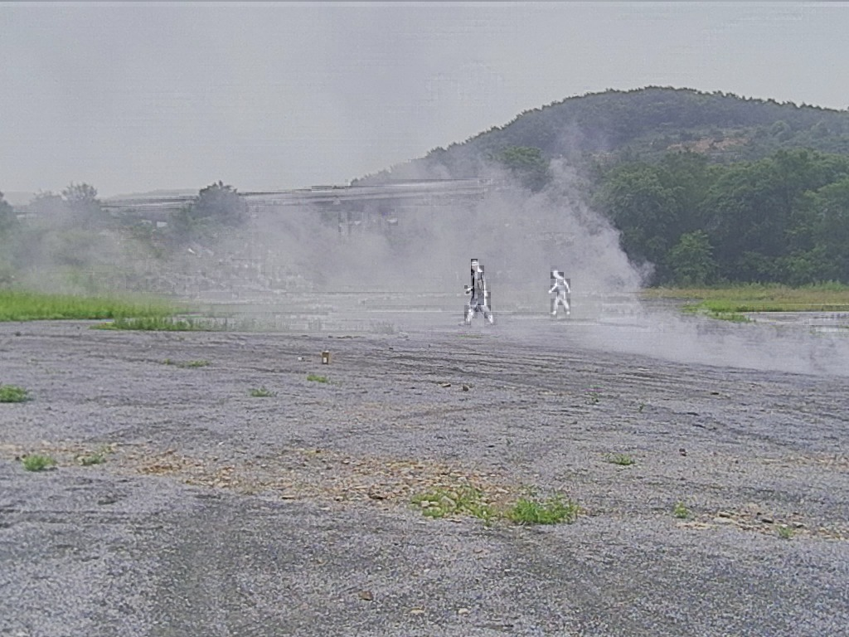

Slide 16
Dual-Tree Complex Wavelet Transform (DTCWT) Fusion
DTCWT is an enhancement over DWT, addressing its shift-sensitivity and directional limitations. It introduces complex wavelets, which improve edge alignment and reduce artifacts. DTCWT fusion follows a similar decomposition-fusion-reconstruction process, but it retains better directional selectivity and reduces ringing artifacts. This makes it an excellent choice for medical and satellite imaging applications. However, it is computationally intensive compared to DWT.
Key Advantage: Improved directional sensitivity and reduced artifacts. Best For: Medical image fusion (CT-MRI).

Slide 17
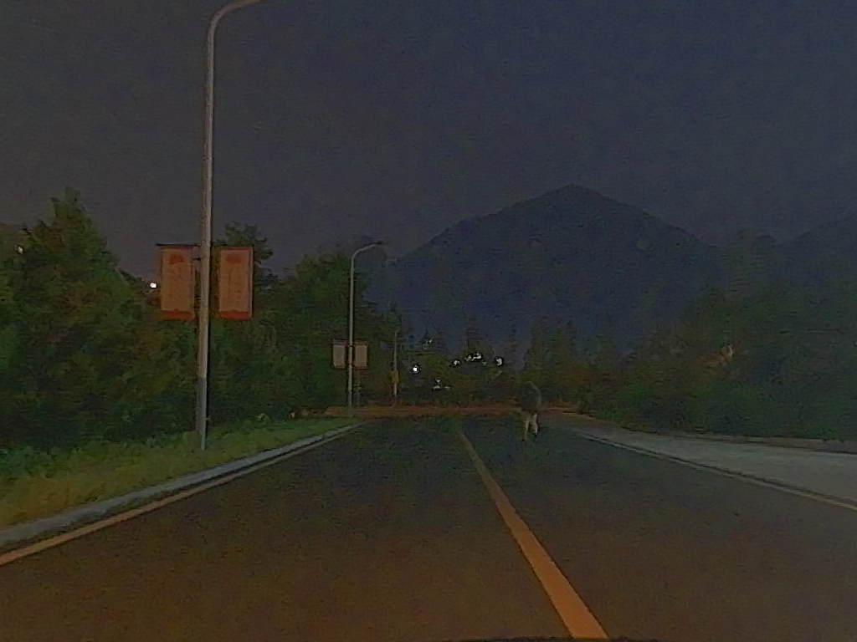
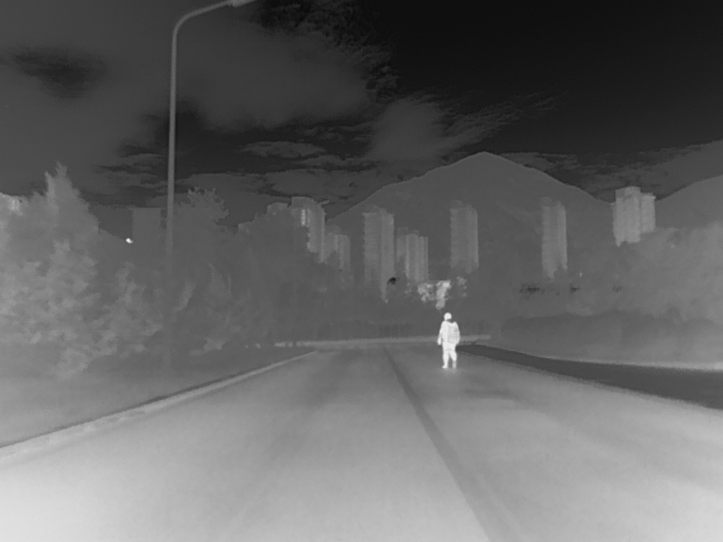
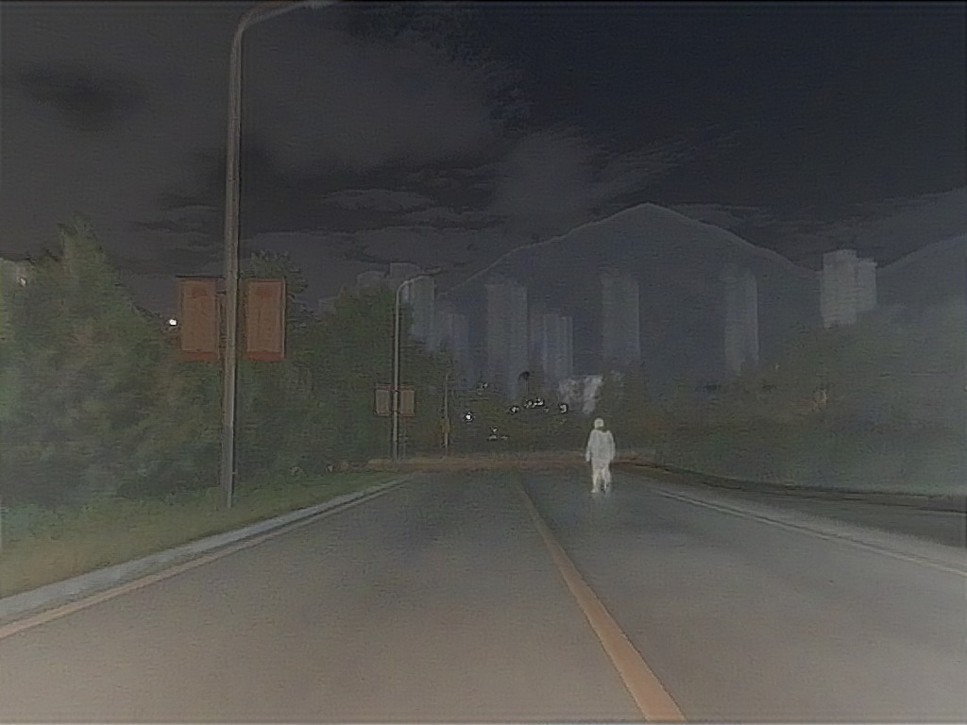

Slide 18
Curvelet Transform Fusion (CVT)
Curvelet Transform Fusion (CVT) is designed to enhance curved and edge-like structures better than wavelets. Unlike DWT, which is good at detecting straight-line features, the Curvelet Transform captures edges and texture details more efficiently. The fusion process involves merging curvelet coefficients from different directional sub-bands. CVT is highly effective in medical imaging (X-ray, MRI) and satellite image fusion, where preserving fine details is crucial. However, it is computationally demanding.
Key Advantage: Best for edge and curve preservation. Best For: Medical and satellite image fusion.

Slide 19
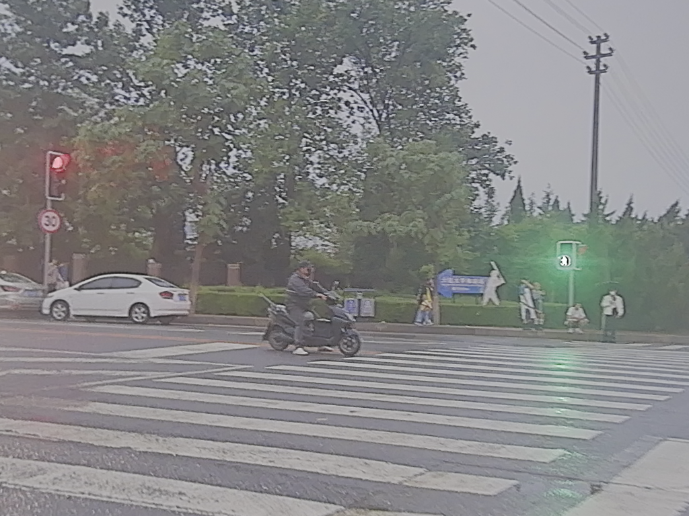
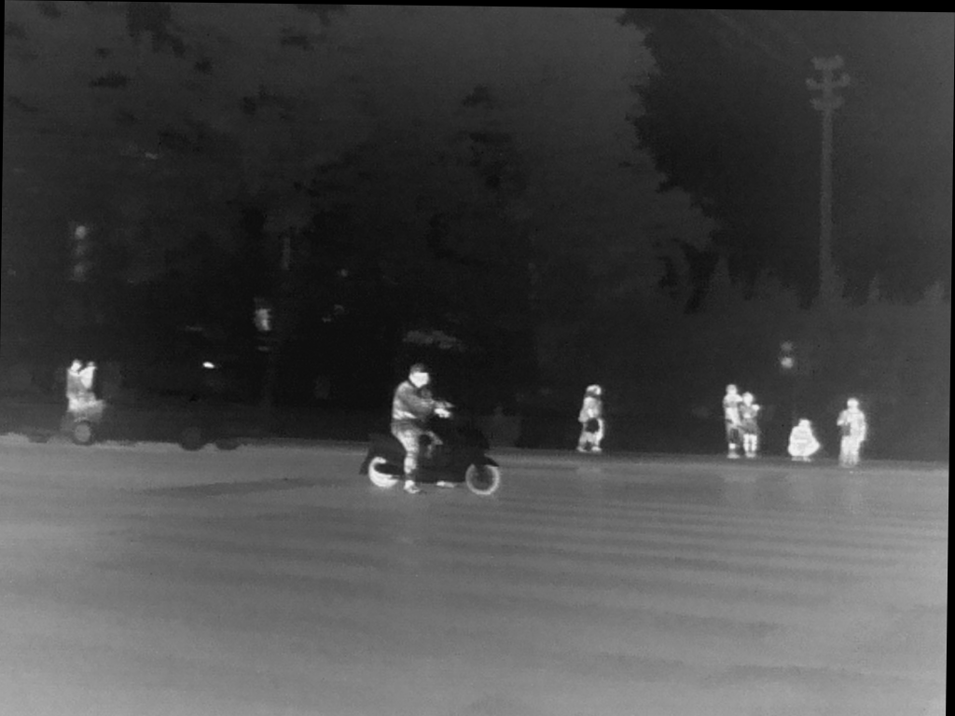
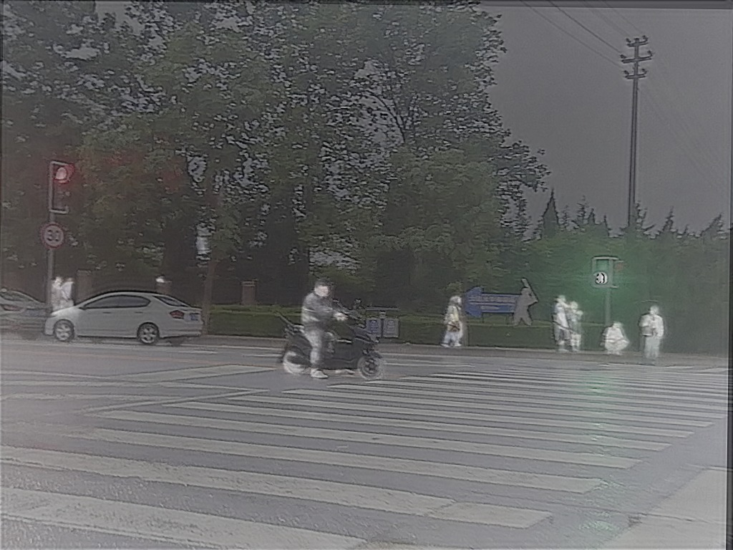
Conclusion & Future Work

Slide 20
Nonsubsampled Contourlet Transform (NSCT) Fusion
NSCT is a multi-scale, multi-directional transform that captures texture, edges, and contours more effectively than wavelets. It is shift-invariant, meaning the fused image retains more structural details than DWT-based methods. NSCT is commonly used in infrared-visible image fusion for surveillance and military applications. However, its high computational cost makes it unsuitable for real-time applications.
Key Advantage: Excellent detail and contour preservation. Best For: Infrared-visible and multi-sensor fusion.

Slide 21
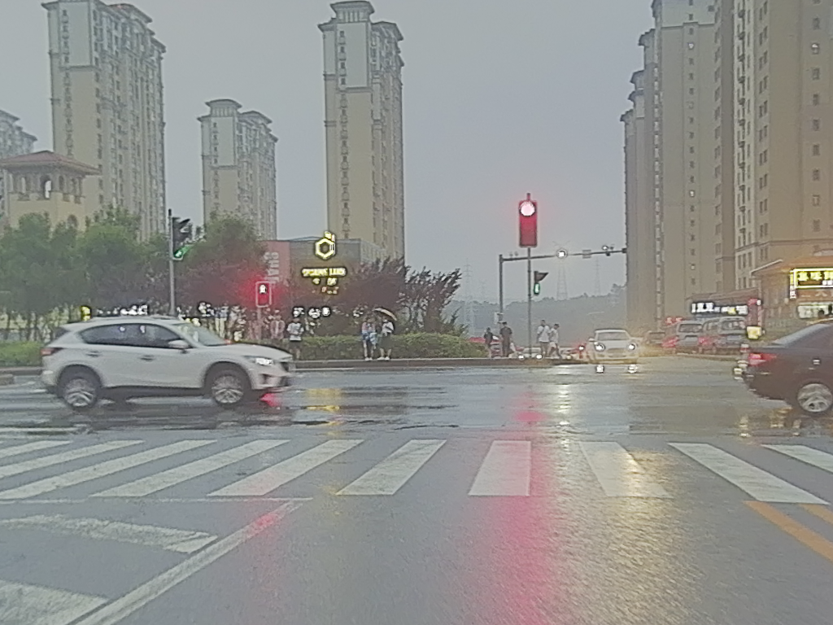
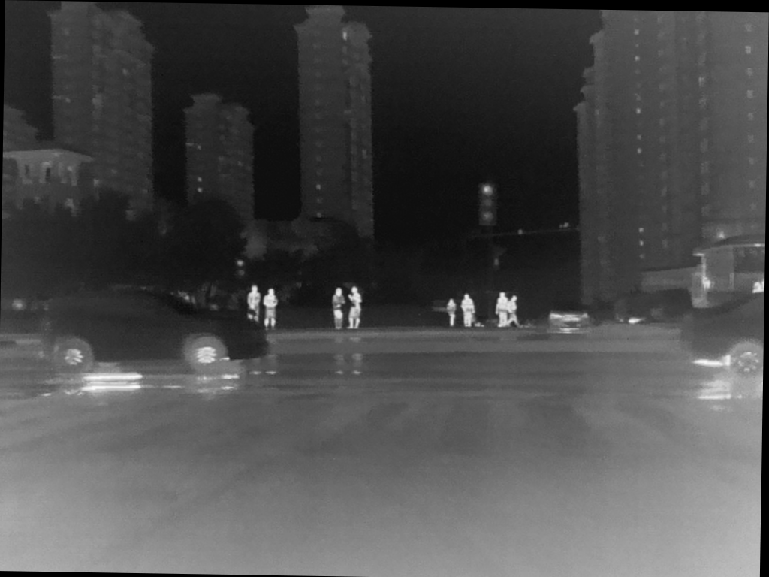
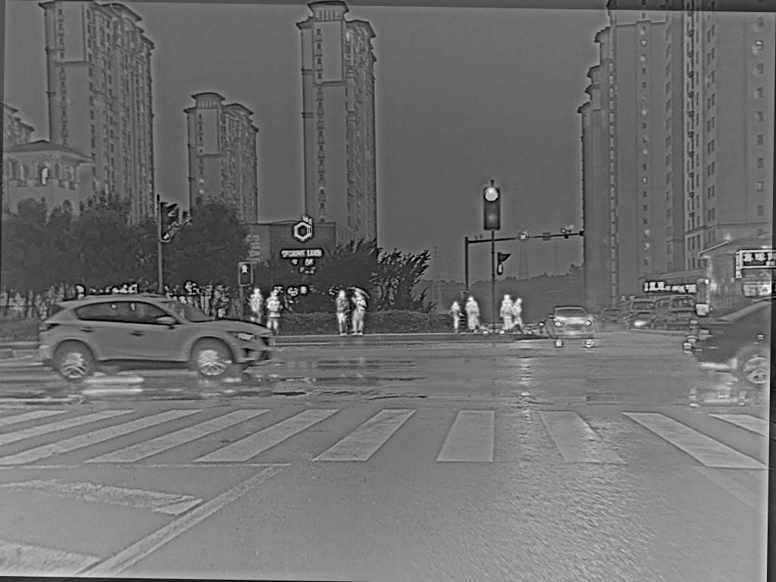
Conclusion & Future Work

Slide 22
Implementation code
clc; clear; close all;
% Define paths
vi_folder = "C:\Users\HP\Documents\MATLAB\M3FD_Fusion\vis1";
ir_folder = "C:\Users\HP\Documents\MATLAB\M3FD_Fusion\ir1";
output_base_folder = "C:\Users\HP\Documents\MATLAB\M3FD_Fusion\";
% Define fusion methods
fusion_methods = {"lp_fuse", "rp_fuse", "curvelet_fuse", "dtcwt_fuse", "nsct_fuse", "dwt_fuse"};
% Define parameters for each method
params = struct("lp_fuse", [5, 1, 1], ...
"rp_fuse", [5, 1, 1], ...
"curvelet_fuse", [3], ...
"dtcwt_fuse", [2], ...
"nsct_fuse", {[2, 3, 3, 4]}, ...
"dwt_fuse", [3]);
% Get list of images
vi_images = dir(fullfile(vi_folder, '*.png'));
ir_images = dir(fullfile(ir_folder, '*.png'));
% Extract filenames
vi_names = {vi_images.name};
ir_names = {ir_images.name};

Slide 23
PERFORMANCE METRICS
% Apply fusion on each RGB channel separately
fused_img = zeros(size(vi_img));
for c = 1:3
fused_img(:,:,c) = feval(method, vi_img(:,:,c), ir_img(:,:,c), params.(method));
end
% Stop timing
computation_time = toc;
% Compute performance metrics
sd_value = computeSD(fused_img);
sf_value = computeSF(fused_img);
entropy_value = computeEntropy(fused_img);
fqi_value = computeFQI(rgb2gray(vi_img), rgb2gray(ir_img), rgb2gray(fused_img));
qabf_value = Qp_ABF(rgb2gray(vi_img), rgb2gray(ir_img), rgb2gray(fused_img));
qcv_value = compute_QCV(vi_img, ir_img, fused_img);
vif_value = compute_VIF(vi_img, ir_img, fused_img);
ce_value = compute_CE(vi_img, ir_img, fused_img);

Slide 24
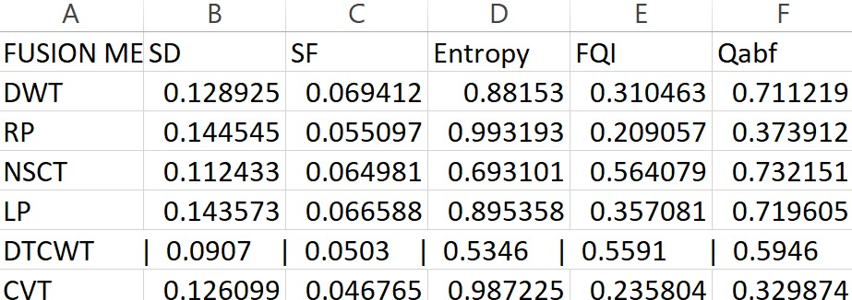
Performance metrics

Slide 25
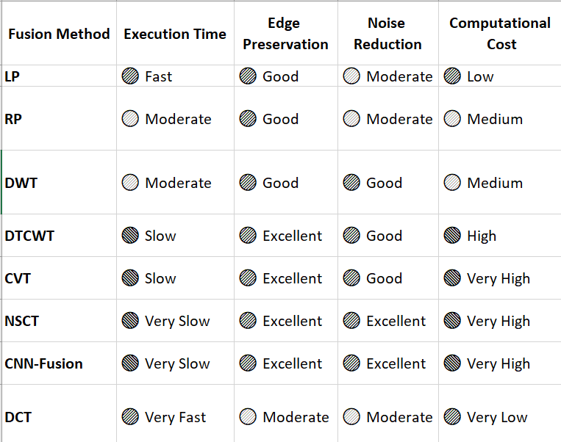
Performance metrics

Slide 26
CONCLUSION
Image fusion in the RGB color space is a direct approach to combining multi-source images while preserving natural color representation. By applying fusion techniques separately to each Red (R), Green (G), and Blue (B) channel, we ensure that important features from both input images are retained without significant color distortion.
RGB fusion methods, such as Laplacian Pyramid (LP), Discrete Wavelet Transform (DWT), Dual-Tree Complex Wavelet Transform (DTCWT), and CNN-based fusion, allow for the enhancement of edge details, contrast, and texture information while maintaining the original color characteristics. However, one challenge of RGB fusion is that color channels are highly correlated, which may lead to redundancy and color distortions if not handled carefully.
To address these limitations, some advanced techniques perform fusion in other color spaces (e.g., YCbCr, LAB) where intensity and color are separated before fusion. Despite this, RGB-based fusion remains widely used in multi-modal image processing, remote sensing, and medical imaging due to its simplicity and ease of visualization. The choice of an RGB fusion method depends on the level of detail preservation, computational efficiency, and the specific application requirements.
In summary, RGB color space fusion provides a visually interpretable, easy-to-implement approach for combining multi-source images, making it suitable for real-time applications and human-centric visual analysis. However, for applications requiring better contrast enhancement and perceptual brightness preservation, alternative color spaces should be considered

Slide 27
THANK YOU
Have a Great Day !

